Slide 1


Slide 2

Phoenix College ASCEND 2019-2020: Technology and Achievements

Slide 3
The Team
Mechanical/Housing
Constantino Meza
Shanis Todecheene
Power Distribution
Javier Perez
Atmospheric Profiling
Genesis Ortiz
Video Streaming
Misgana Gebremariam
Samuel Queen
Jay Connolly
Video Stabilization
Meghann Boland
Jonathan Shayeb
Team Lead
Maxx Mudd

Slide 4





Project Goals
Reduce overall weight
Improve power efficiency
Ensure accurate data
Stream to social media via radio communication
Stabilize onboard
HD video

Slide 5
Fall 2019 Summary
Mechanical/Housing
Power Distribution
Atmospheric Profiling
Impact resistant
Well insulated
Weight
Sufficient capacity
Custom PCB
Weight
Captured data
Wiring issues
Sensor diversity
Video Streaming
Video Streaming
YouTube code
Twitter bot
Wiring issues
Stabilized video
Camera quality
Storage capacity

Slide 6
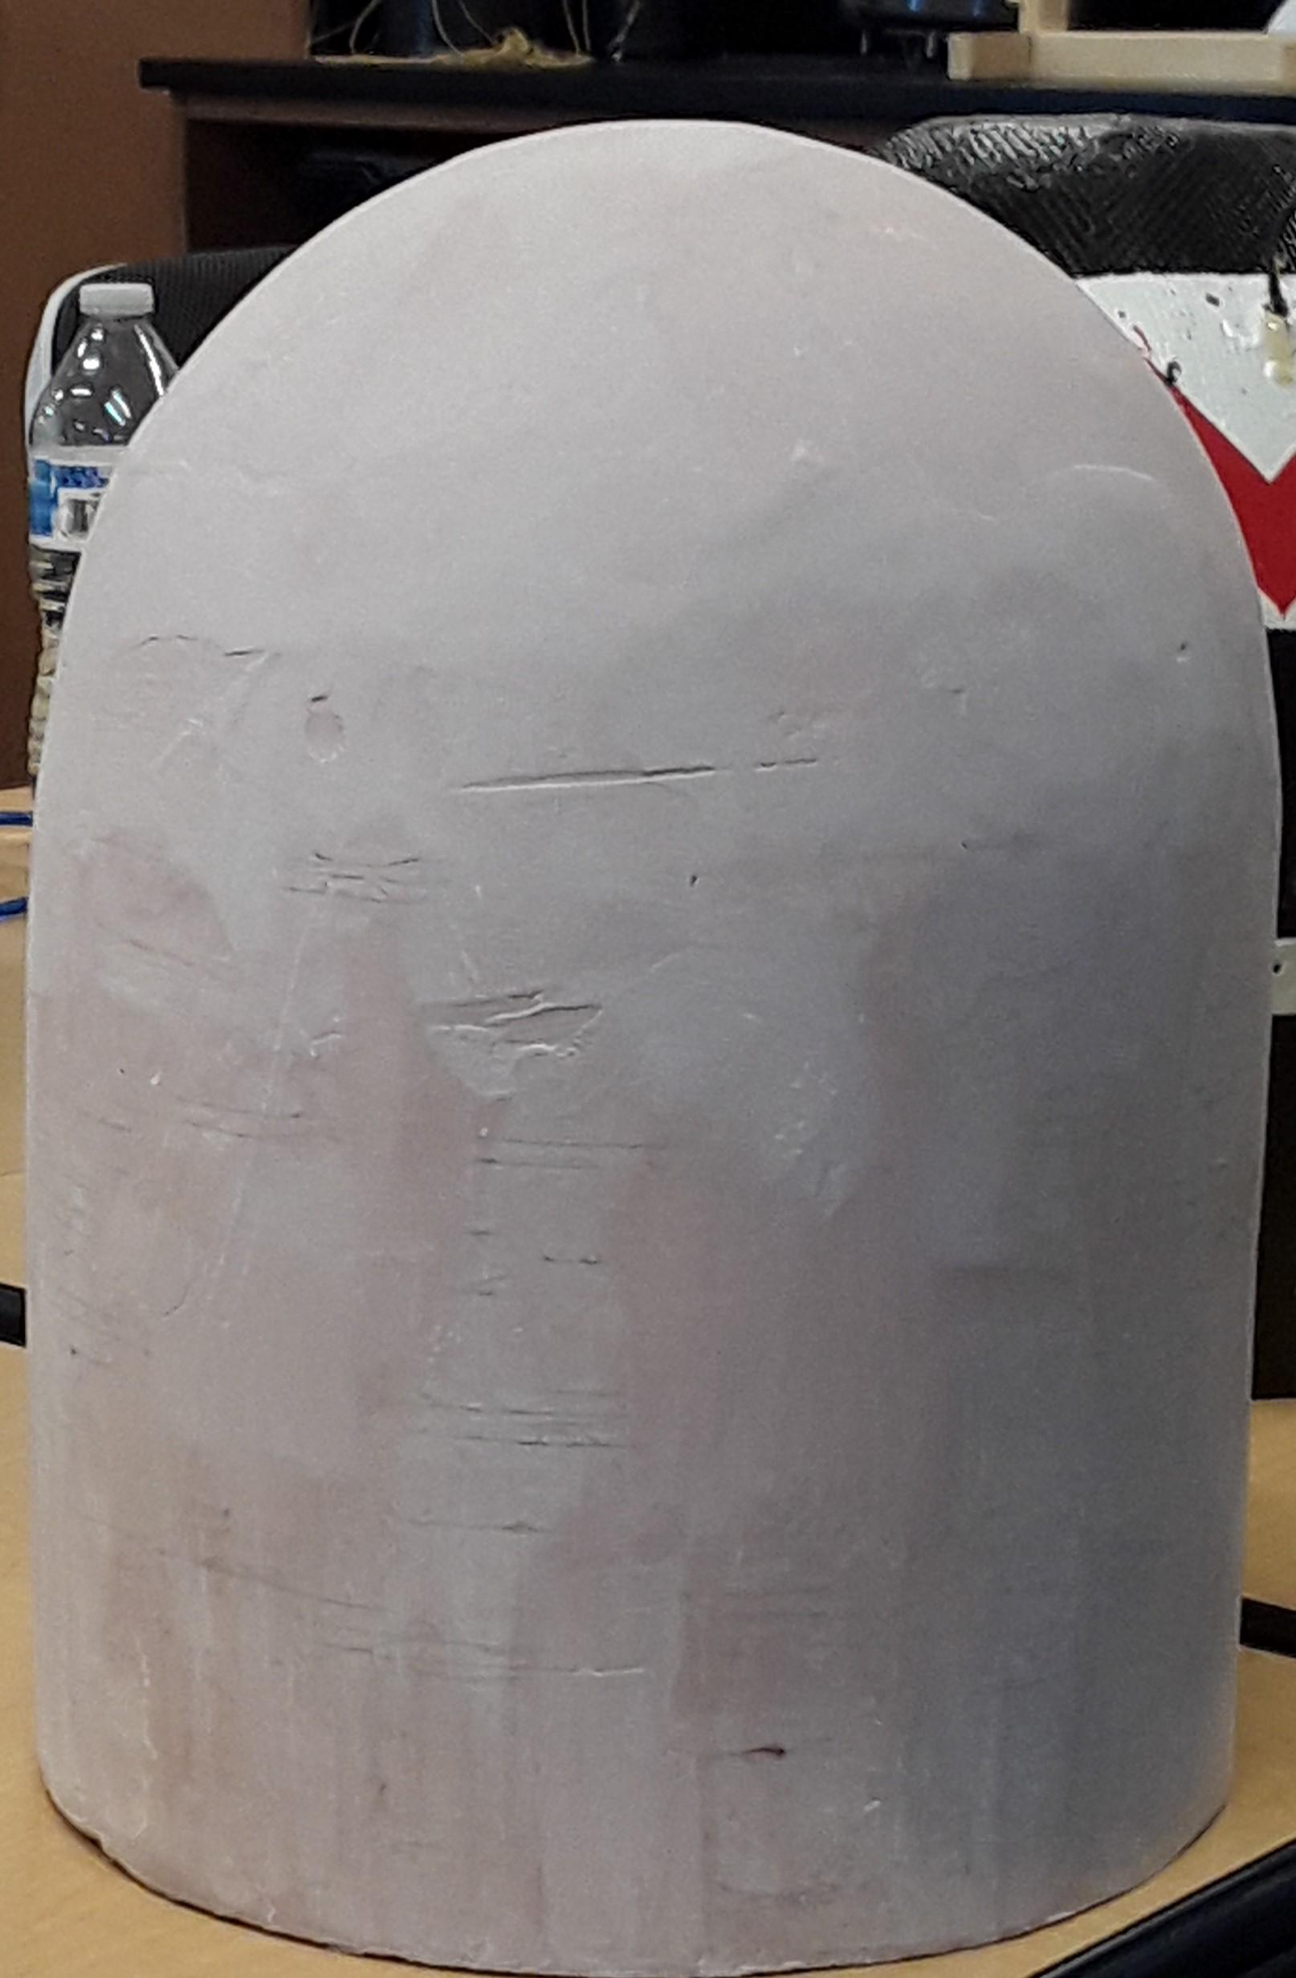
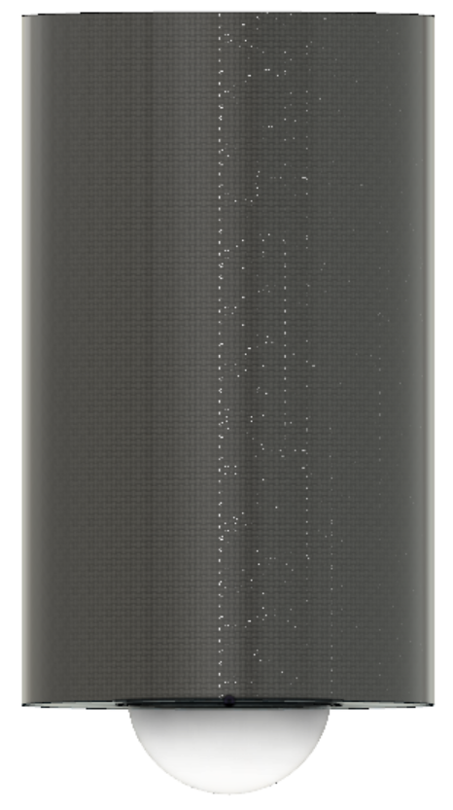
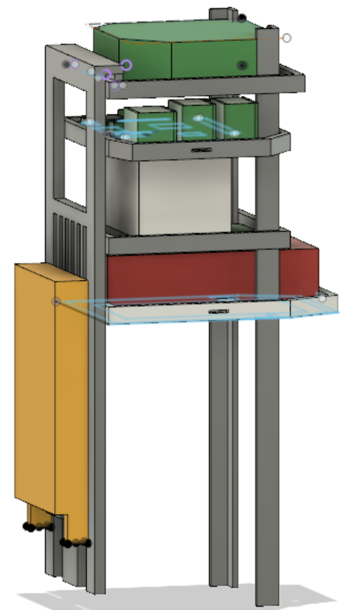
Mechanical/Housing
Lightweight carbon fiber housing
3k carbon fiber fabric
Bondo cardboard molding process
2 to 1 volume epoxy system
Mounting system
3D Printing using ABS
Fusion360 program to design all internal structures and simulations
NASA document on cubesat design
Cubesat design allows us to optimize the space
Suspension system
Kevlars cord method reduces weight

Slide 7
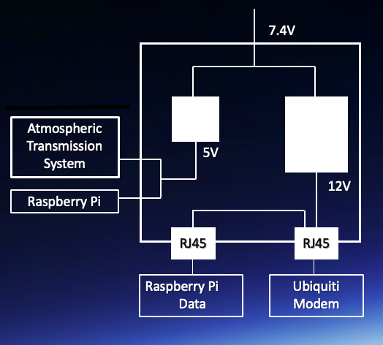
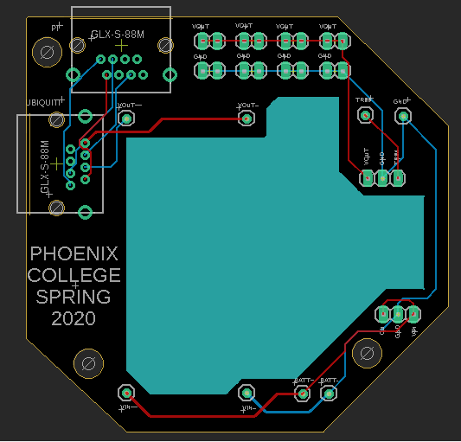
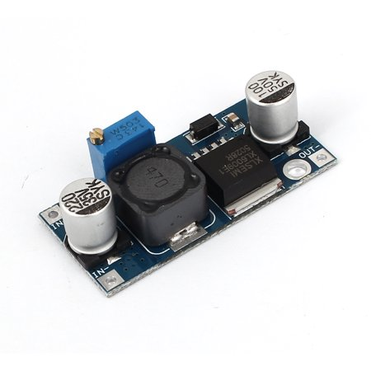
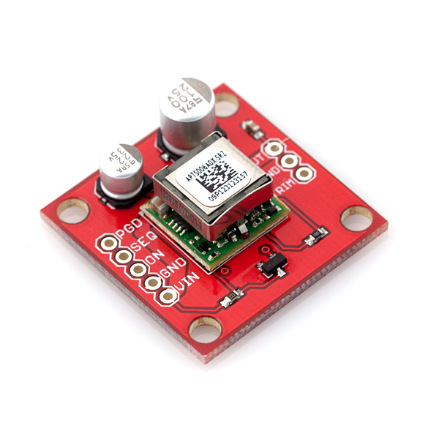
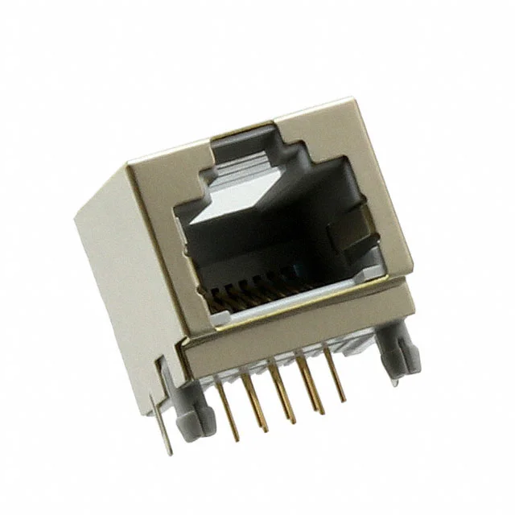
Power Distribution
Lightweight LiPo Battery to guarantee a source of power for the entire system while reducing overall weight
Custom - Designed PCB with cut-out
Two lines sources of power at 5V and 12V
Key Switch to turn on/off the system
Step-Up and Step-Down Converters
RJ45

Slide 8
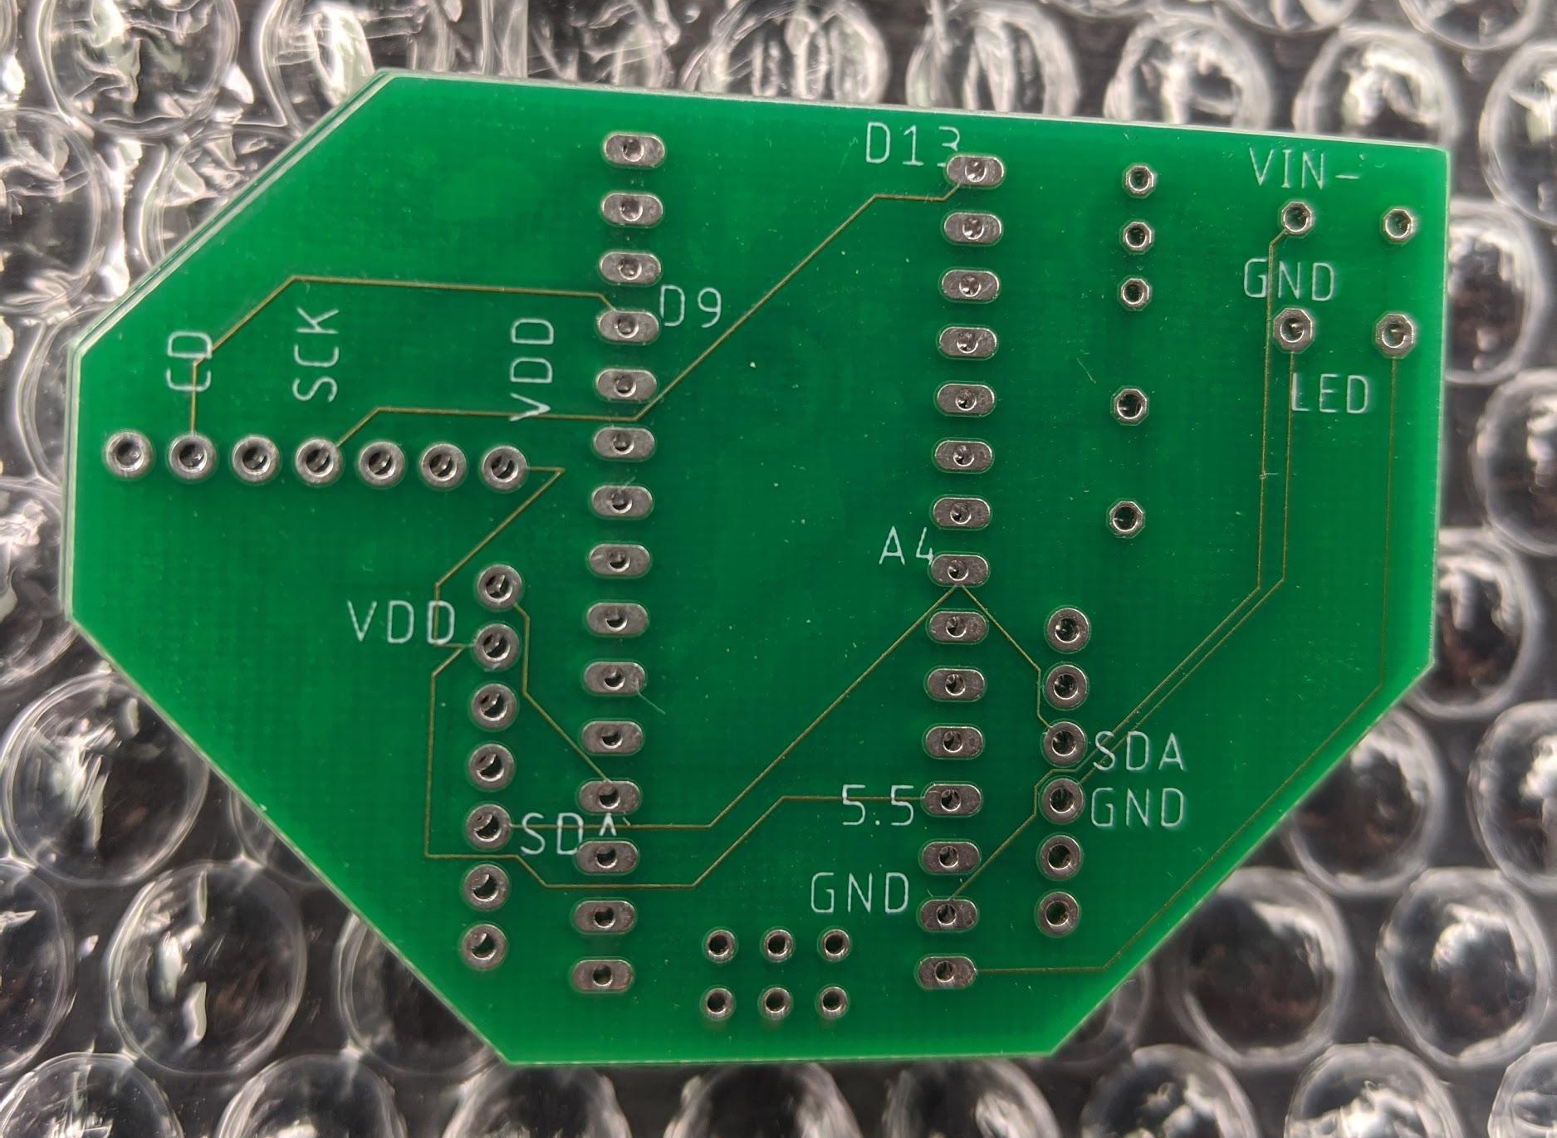
Atmospheric Profiling
Isolated but identical Arduino systems
Custom PCB to improve reliability by reducing points of vulnerability
Local PCB manufacturer (CustomCircuitBoards)
Quality sensors suited for high-altitude and high-precision data collection
Data and memory management for accurate results

Slide 9
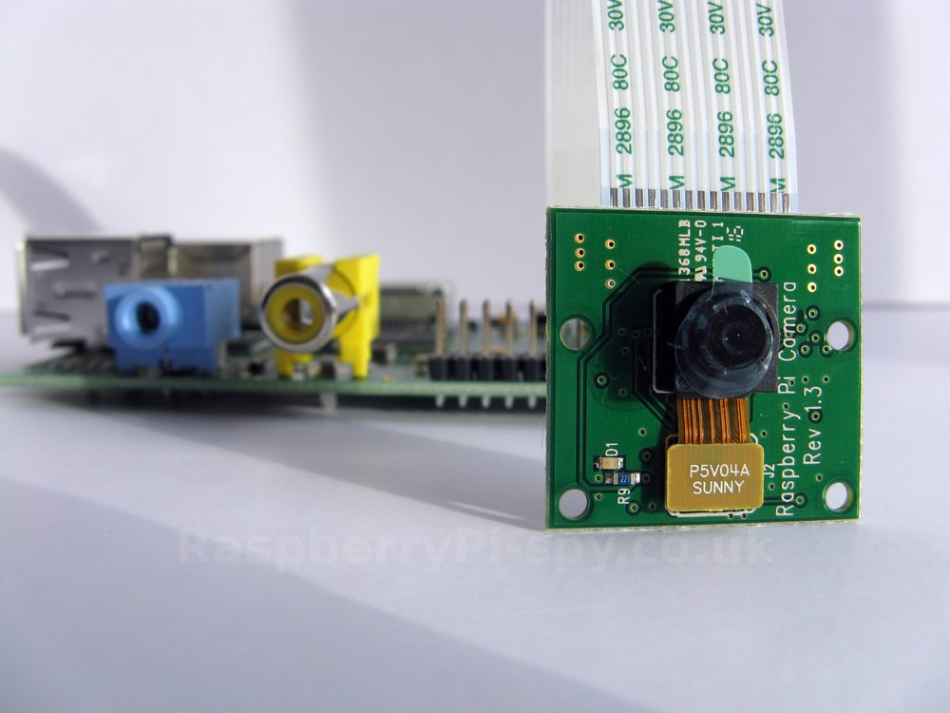
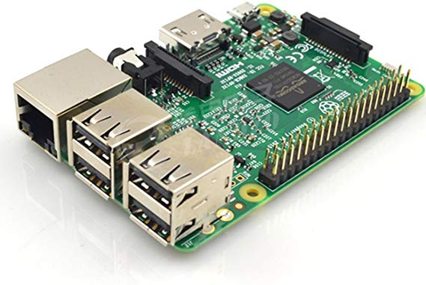


Video Streaming
The live stream was set up on youtube using a Raspberry Pi 3 b+
Ffmpeg used to run the stream
Fswebcam interface for USB camera processing (arducam)
Success with live streaming and twitter updates without using paid services
@pcnasaascend

Slide 10
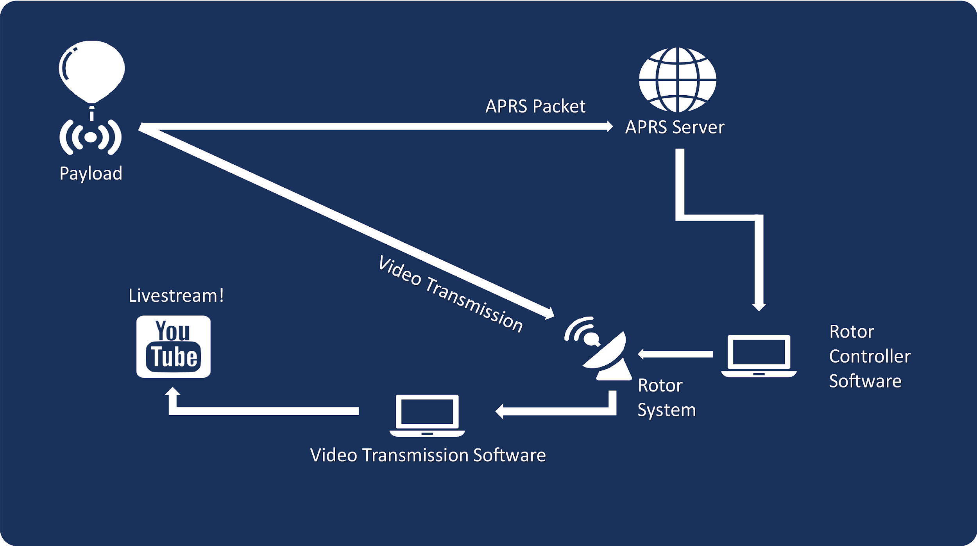
Ground Station
Rotor controller code updated to track APRS call signs efficiently
Cleaning redundant or unnecessary code
Minor circuit changes to maximize the mobility our ground station
Real time atmospheric data monitoring

Slide 11
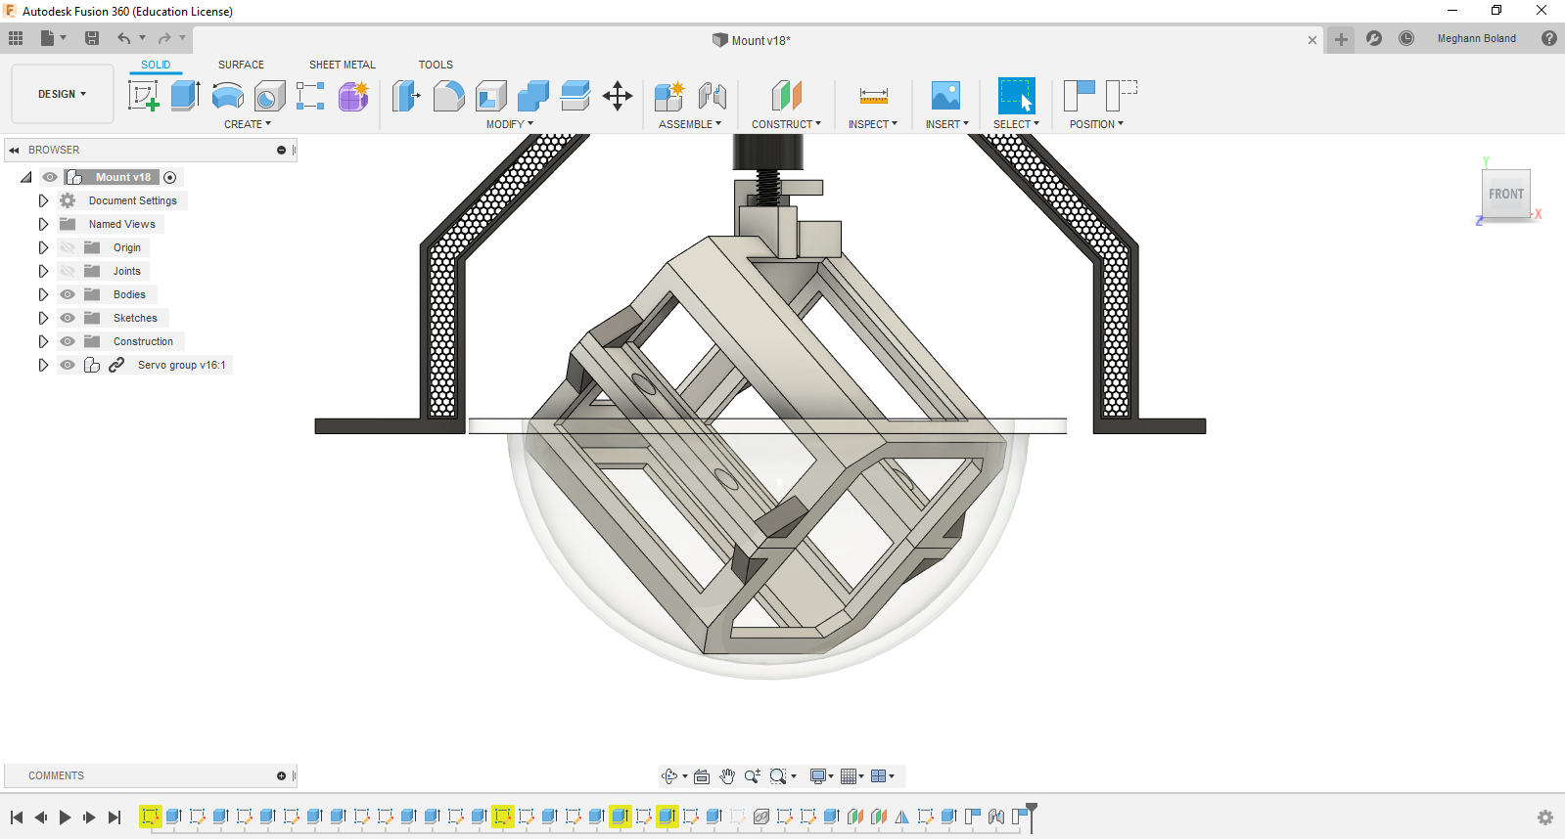
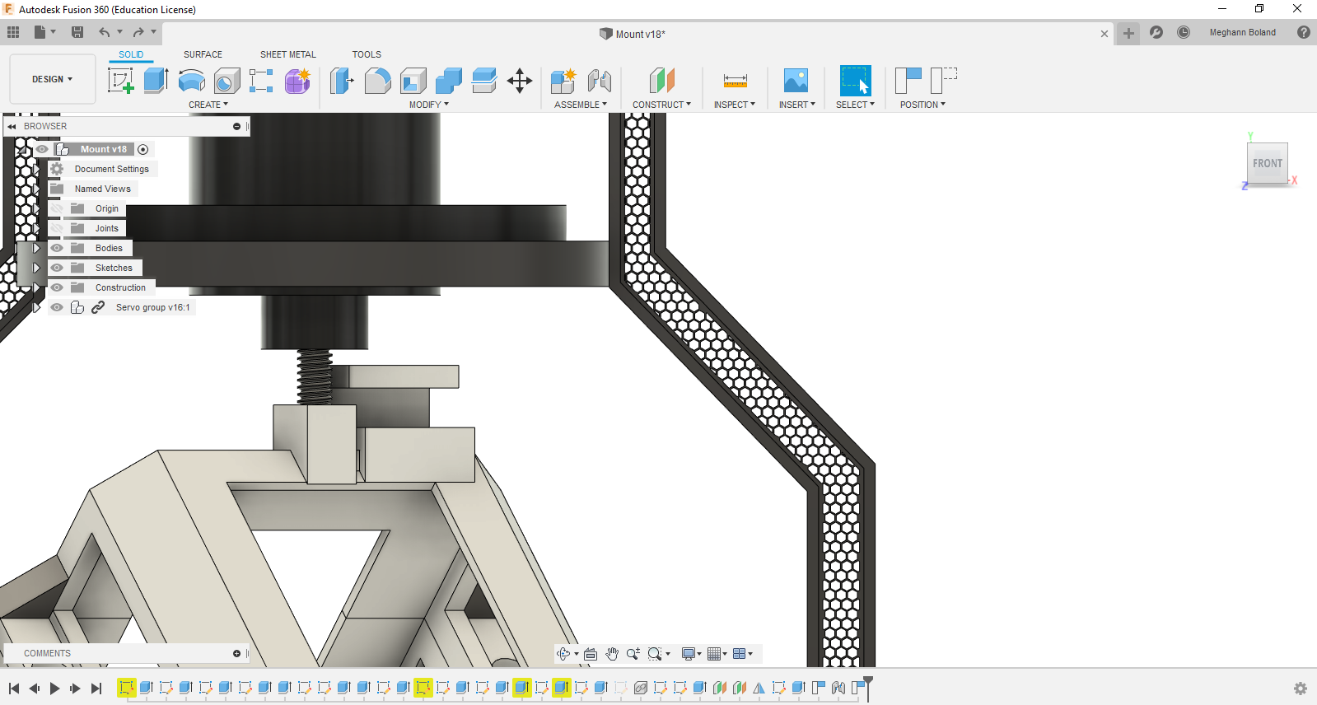
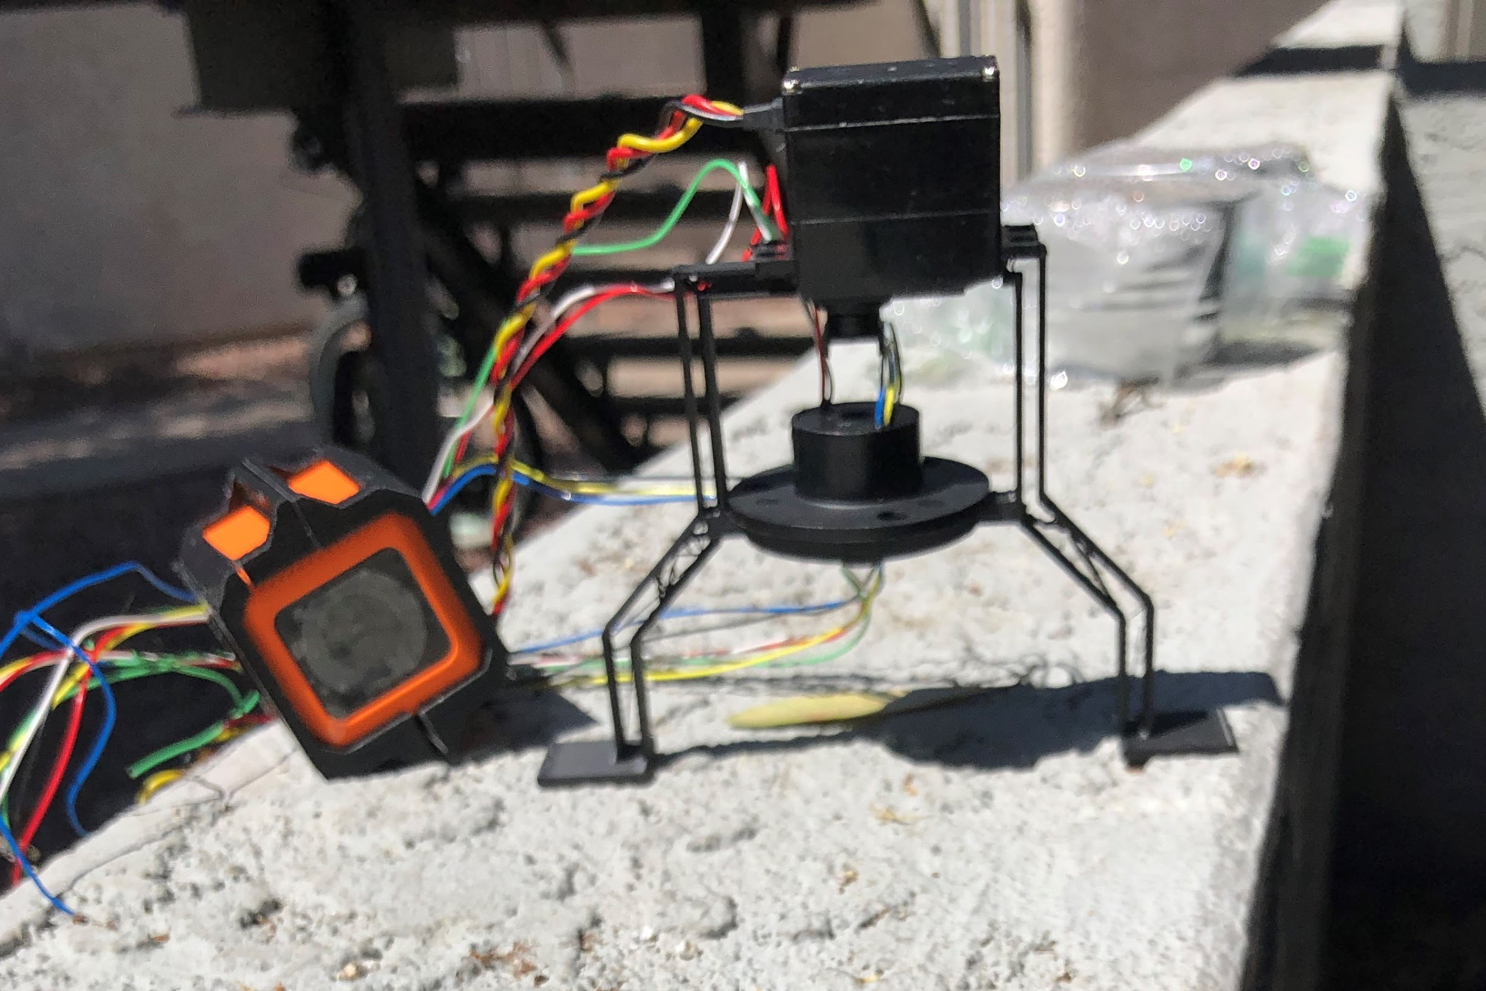
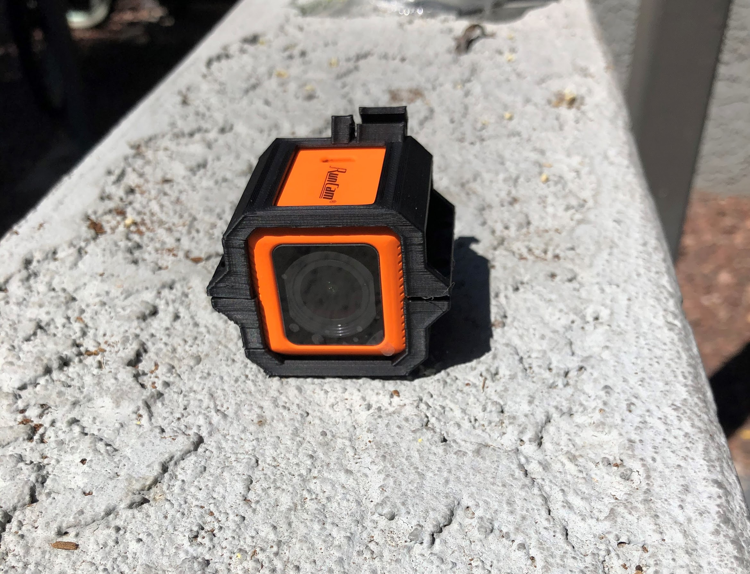
Video Stabilization
Stabilization achieved by using an Arduino Nano, MPU6050 sensor, and a Continuous Rotation Servo.
Use of a slip ring allowed rotation beyond 360 degrees without loss of power or data to the camera and sensor.
Mounts were 3D printed to reduce weight and allow customization.

Slide 12
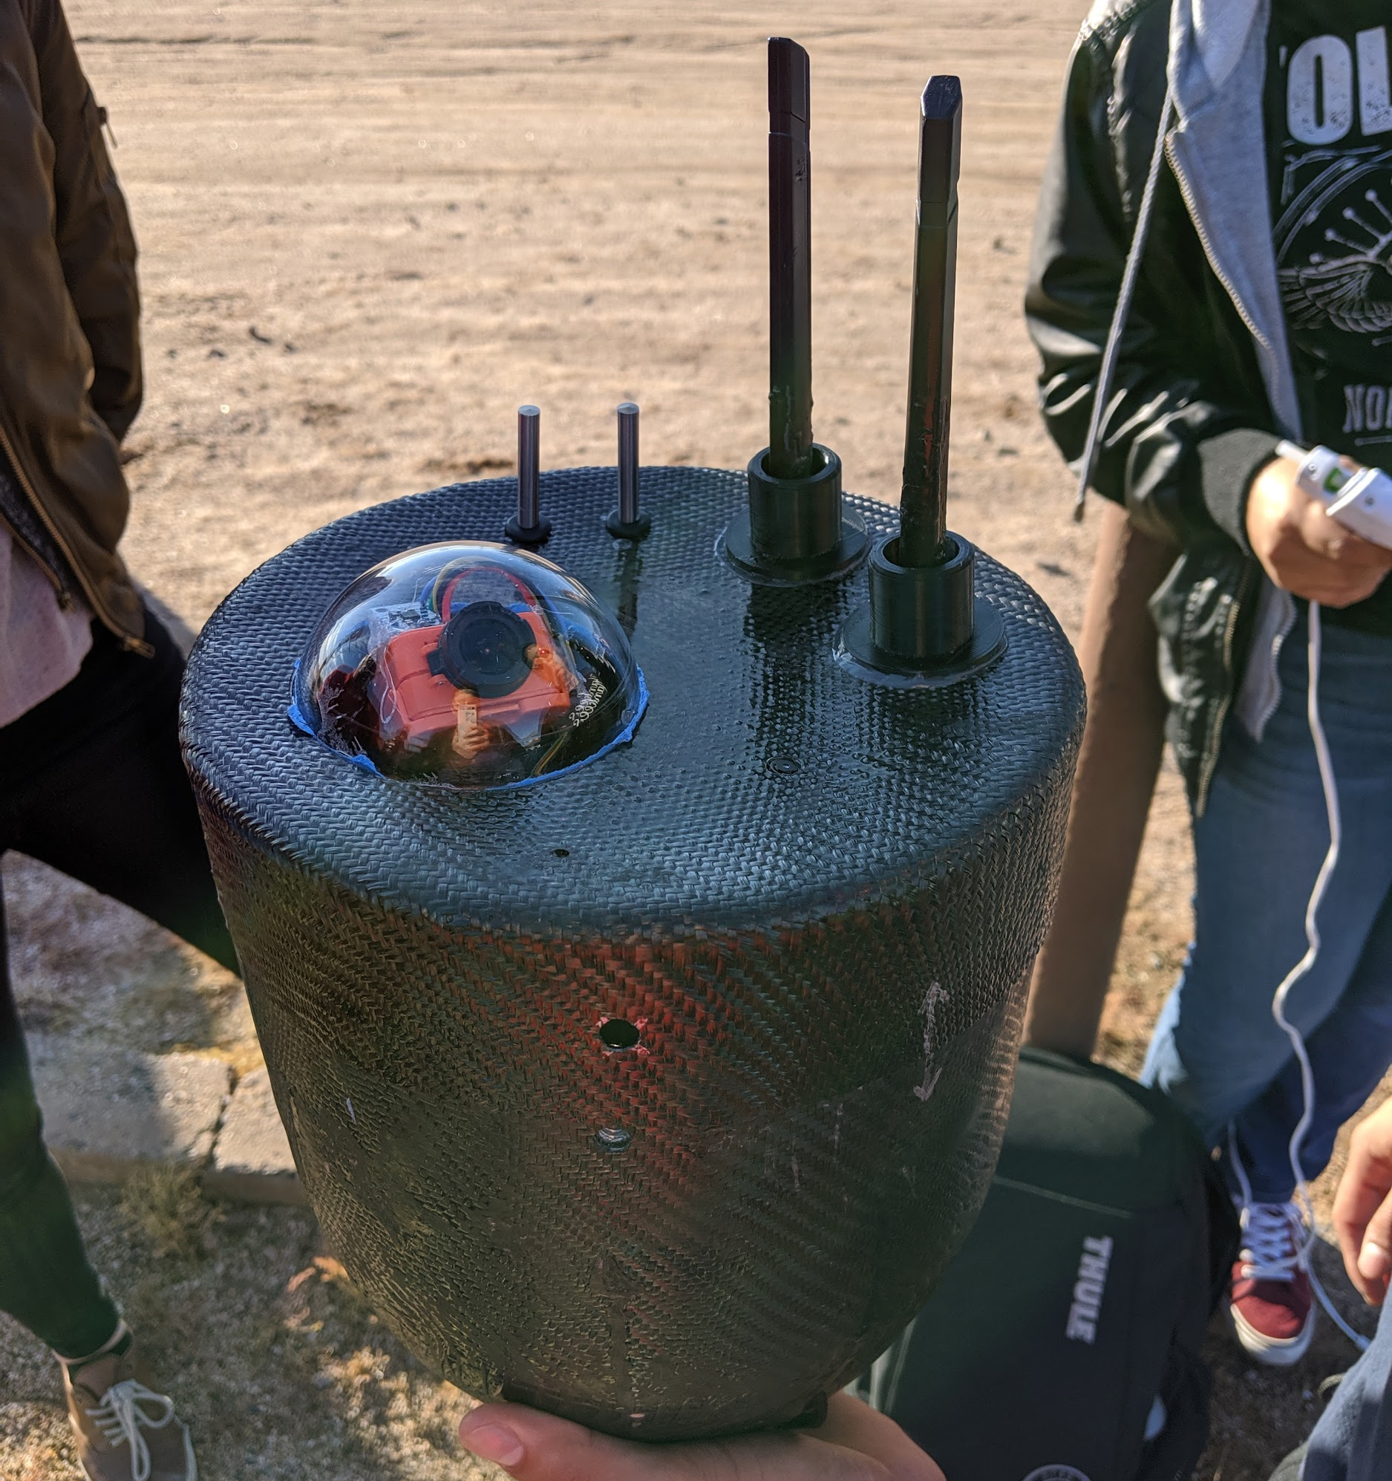
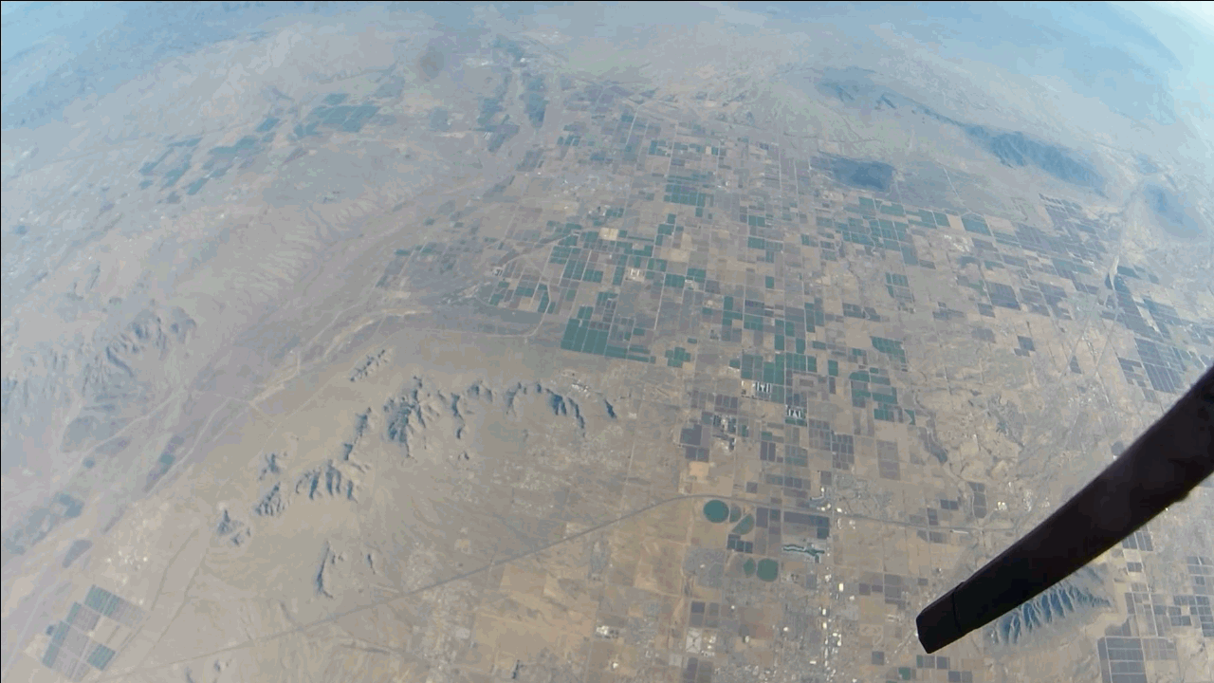
Fall 2019 Payload

Slide 13
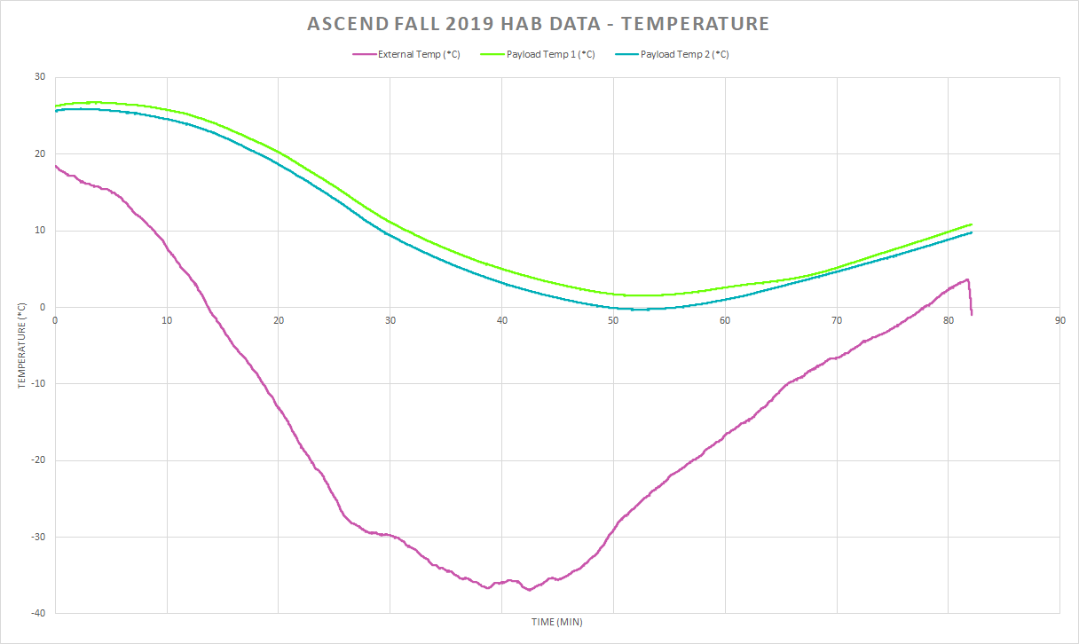
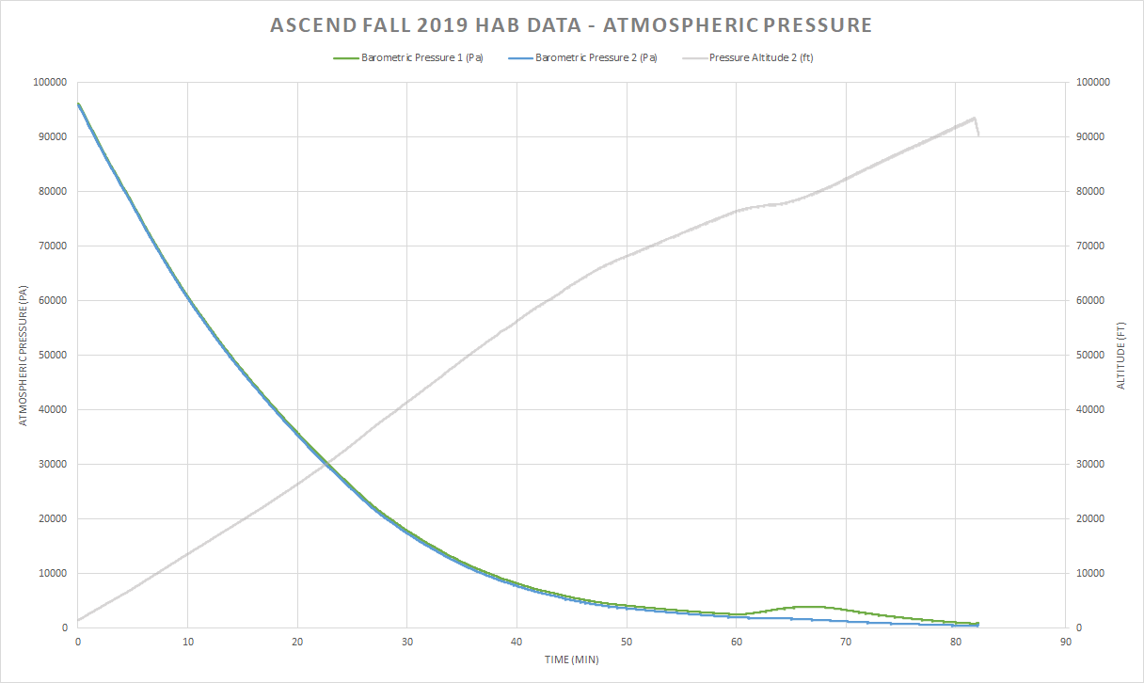
Fall 2019 Data

Slide 14
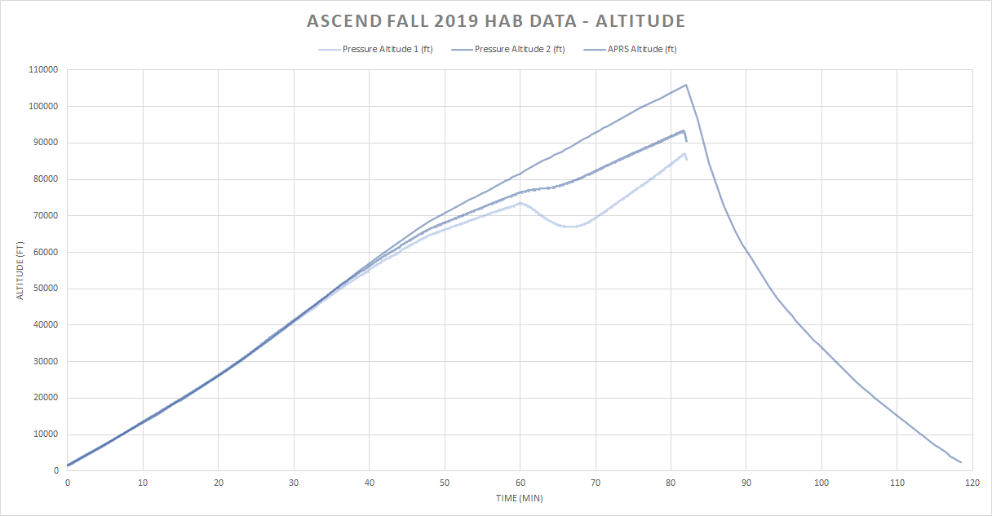
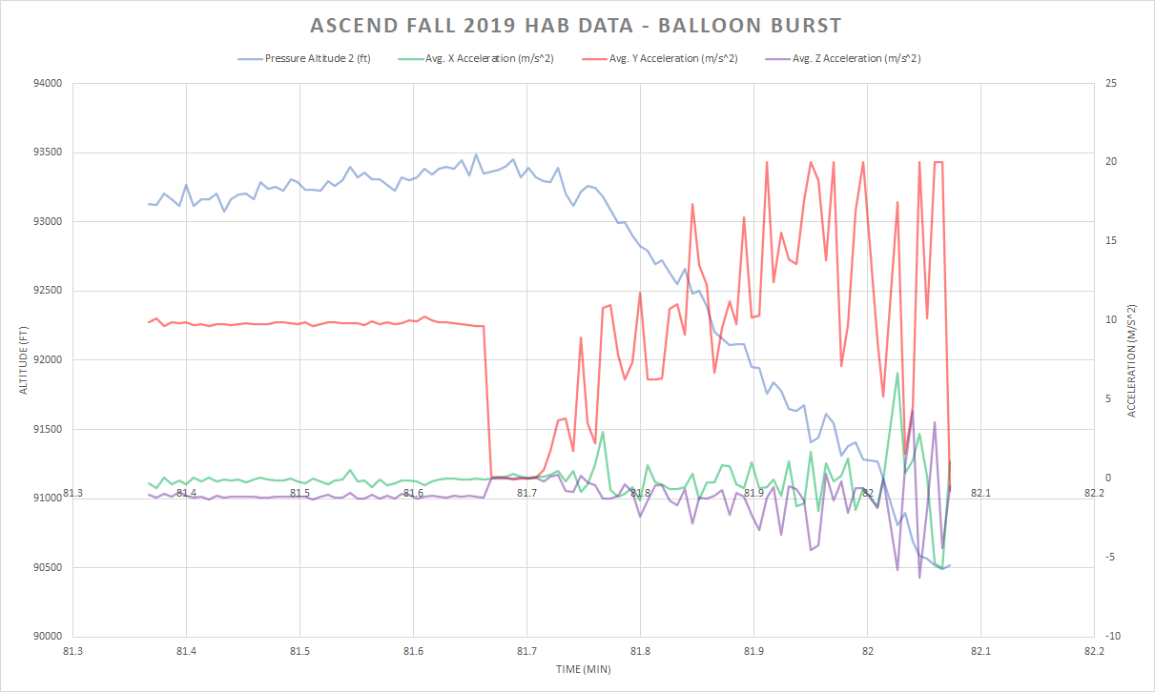
Fall 2019 Data

Slide 15
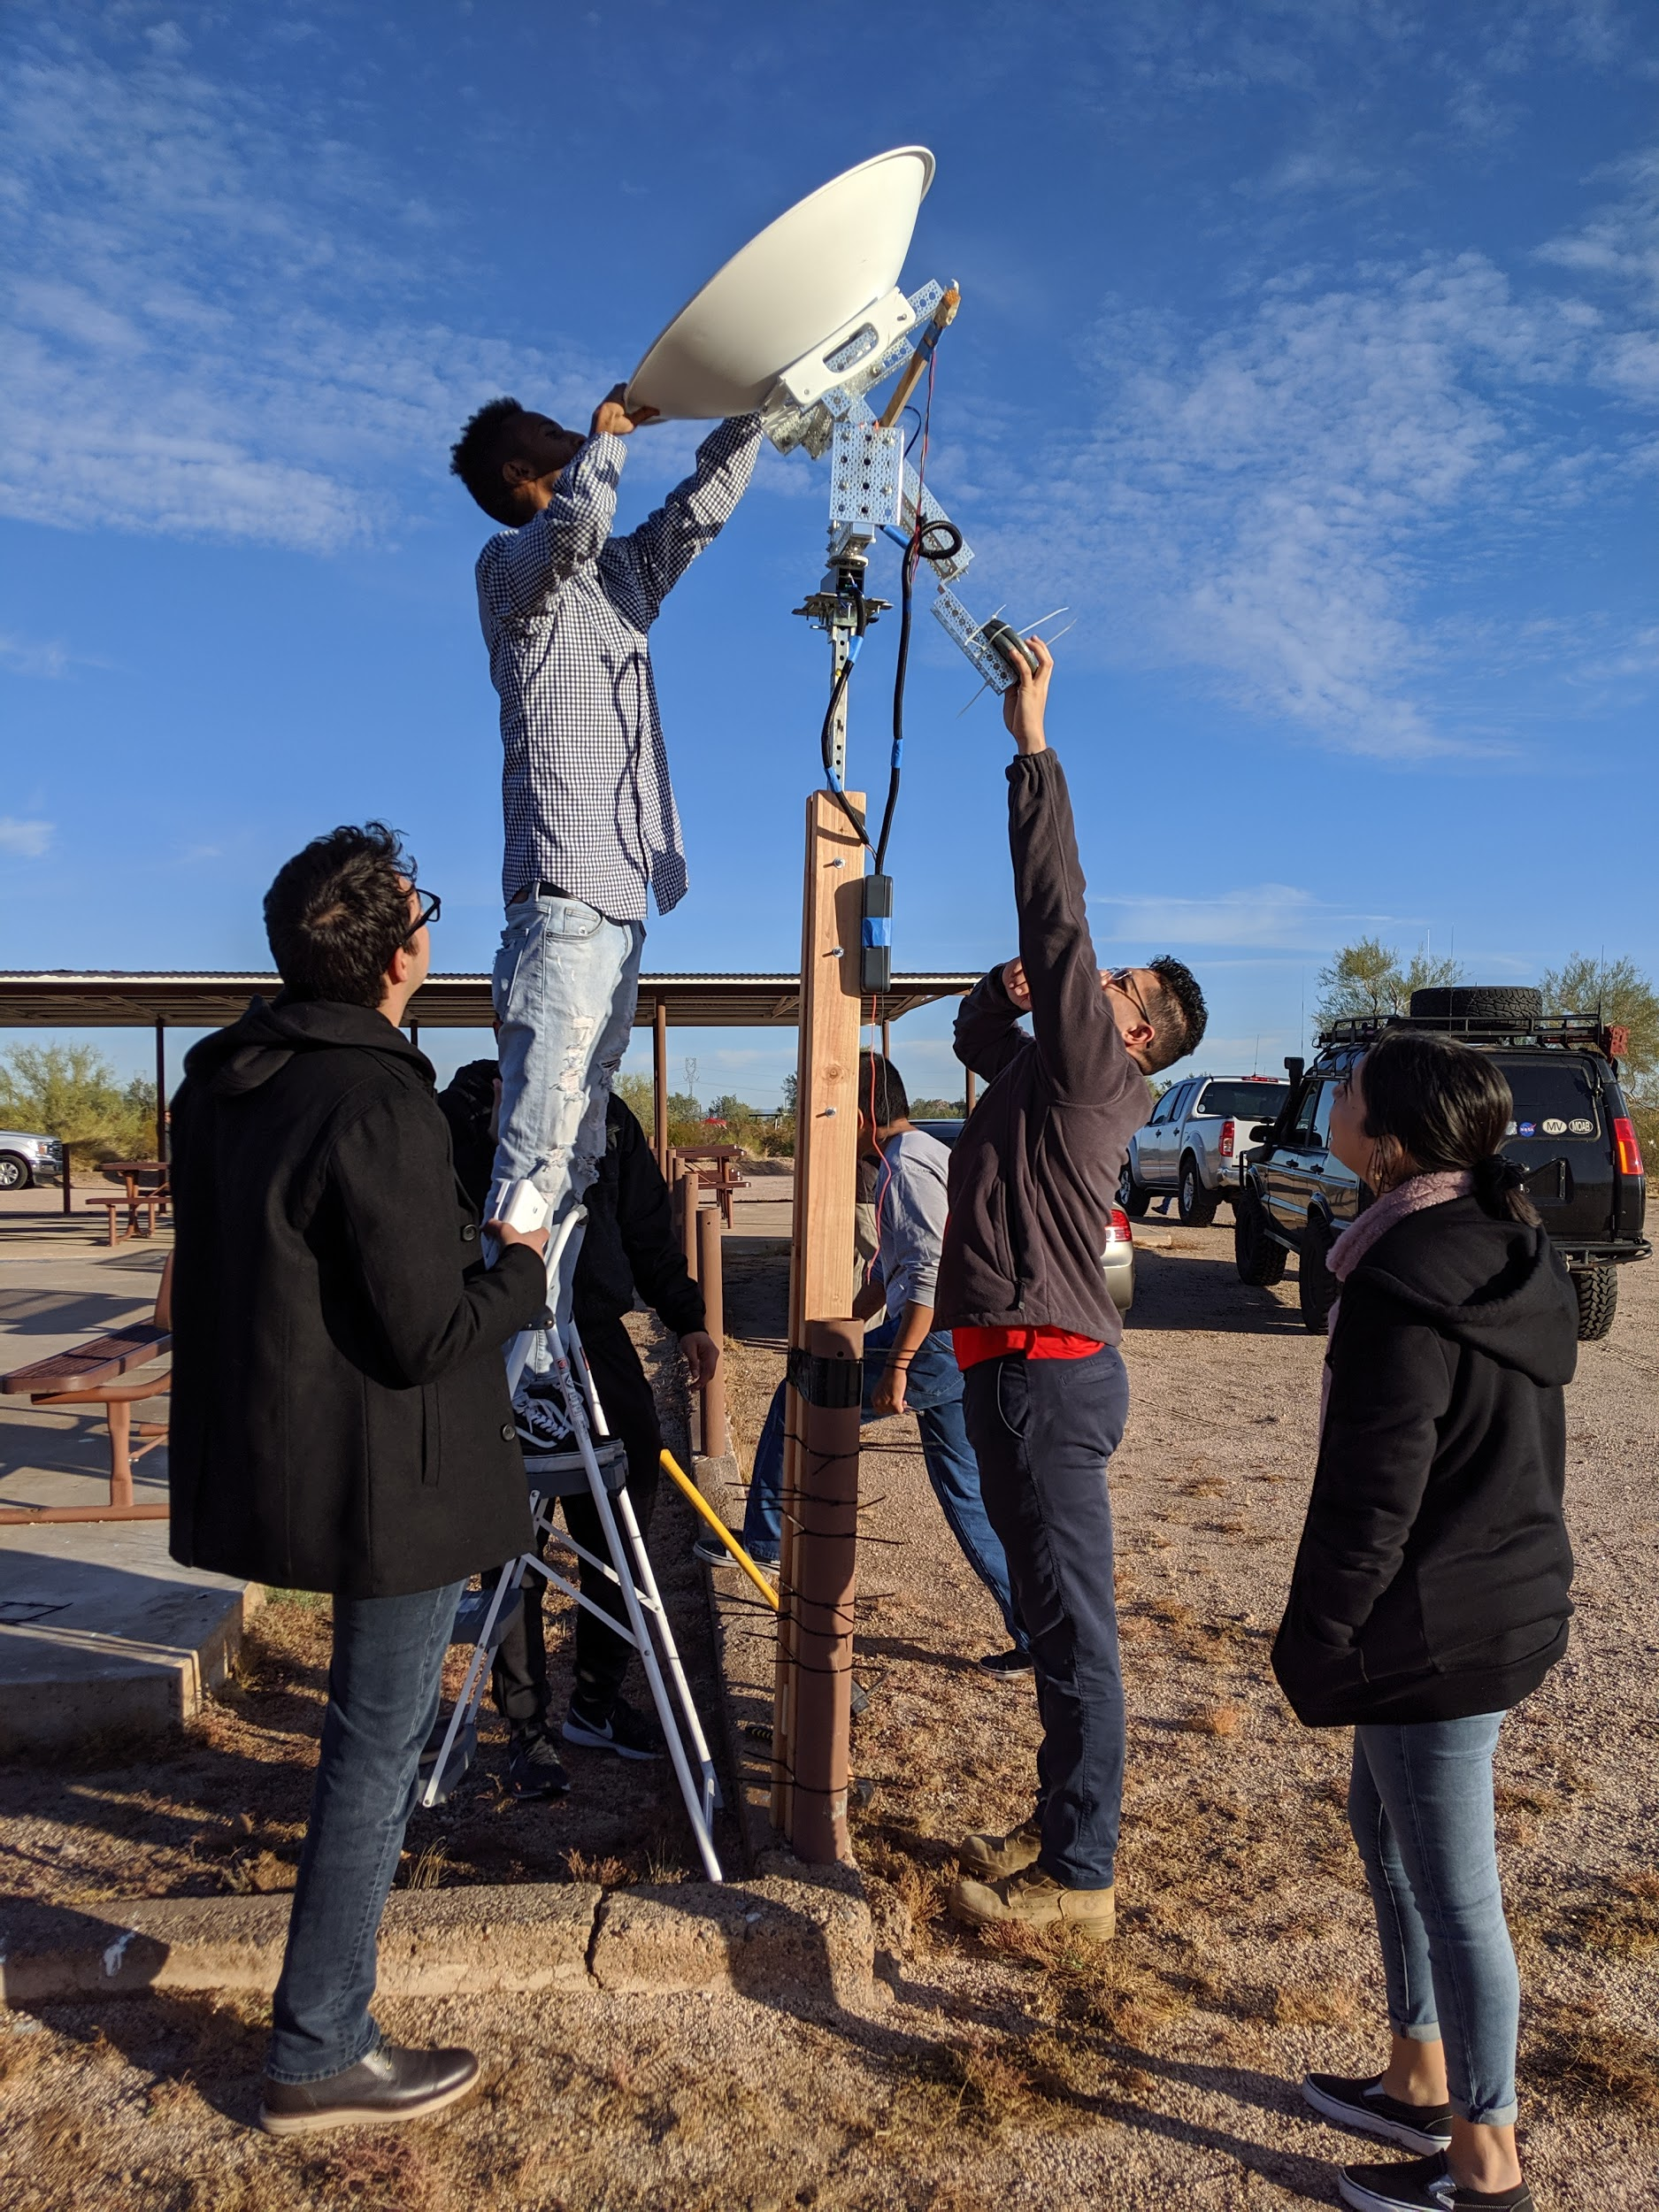
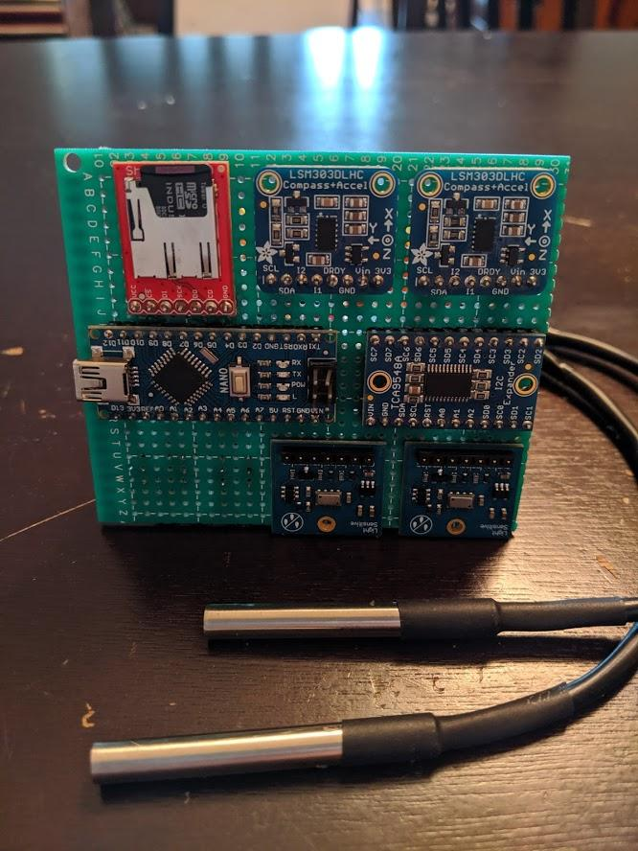
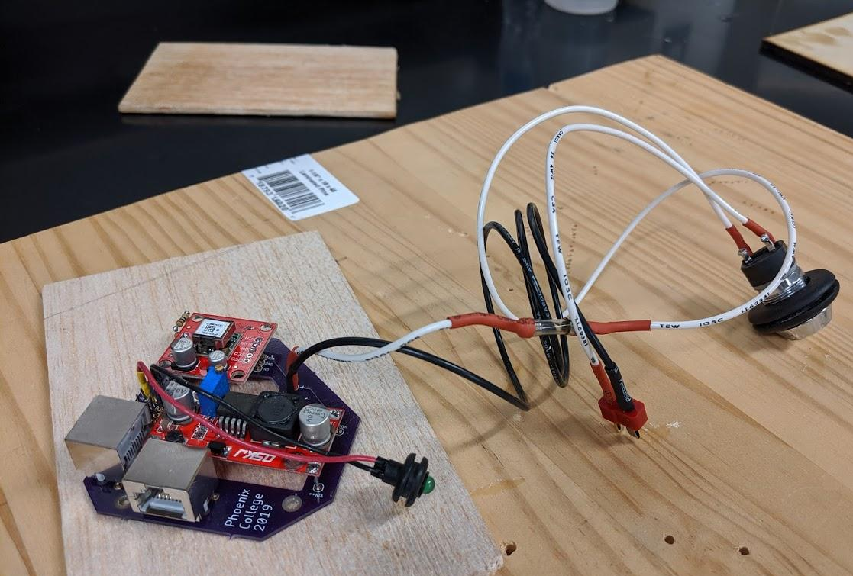
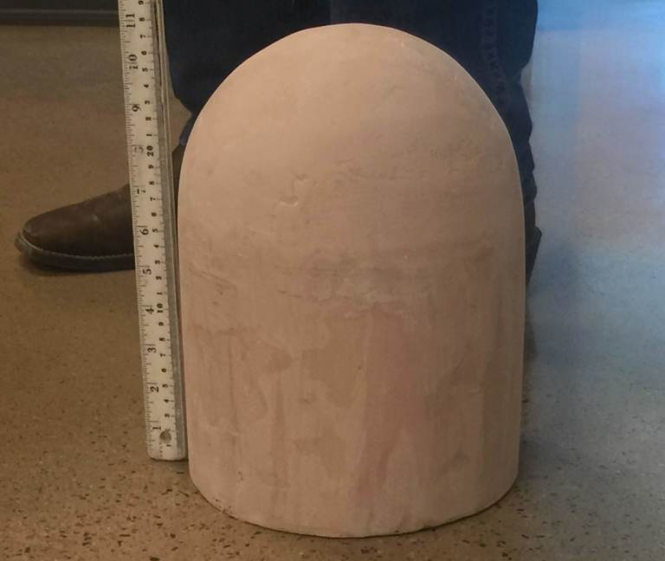
Fall 2019 Build

Slide 16
Thank you!

